Slide 1
Identifying Special Populations & Coding in EIS
ESL, Immigrant, and Homeless Populations
Updated 2/22/16

Slide 2
Agenda
Homeless Populations
Identification Procedures
EIS Coding
ESL Populations
Identification Procedures
EIS Coding
Immigrant Populations
Identification Procedures
EIS Coding

Slide 3
Homeless Identification: Key Points
Families may be sensitive to conversations around homelessness.
Reference legislative wording and contact ASD’s Homeless Liaison if additional guidance is needed.
Make determinations on a case-by-case basis based on the circumstances of each child.
Understand that some cases will be clear-cut; others will require further inquiry and a more nuanced analysis.
Use fixed, regular, and adequate as guiding principles.

Slide 4
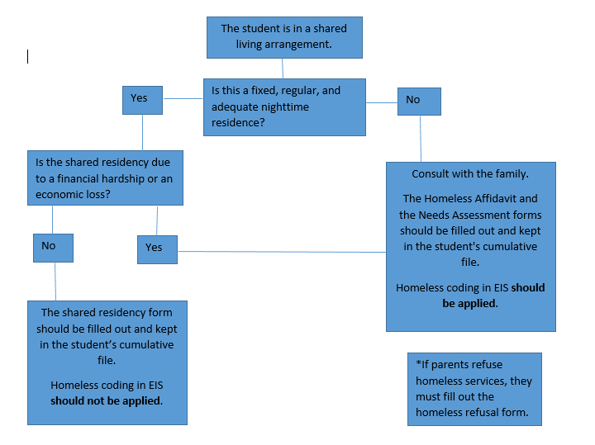
Homeless Identification Flowchart

Slide 5
Definitions of Fixed, Regular, & Adequate
Fixed:
Stationary, permanent, not subject to change
Regular:
Used on a predictable, routine, consistent basis
Consider the relative permanence
Adequate:
Lawfully and reasonably sufficient for meeting the physical and psychological needs typically met in a home environment
*Can the student go to the SAME PLACE (fixed) EVERY NIGHT (regular) to sleep in a SAFE AND SUFFICIENT SPACE (adequate)?

Slide 6
Shared Housing Explained
Legislative wording: “sharing the housing of other persons due to loss of housing, economic hardship, or a similar reason”
Considerations:
Why did the parties move in together? Due to a crisis or by mutual choice as a plan for mutual benefit?
How permanent is the living arrangement intended to be?
Where would the party in crisis live if not sharing housing?
Is the living arrangement fixed, regular, and adequate?

Slide 7
Homeless Identification Procedures
Living in emergency or transitional shelters
Sharing the housing of other persons due to loss of housing, economic hardship, or a similar reason
Living in a public or private place not designed for or ordinarily used as a regular sleeping accommodation for human beings (e.g. motels, cars, abandoned spaces, etc…)
Children or youth who lack a fixed, regular, and adequate nighttime residence
Awaiting foster care placement

Slide 8
Homeless EIS Coding
Three data fields related to homelessness are reported through the 41 (Student Enrollment) extract. See State/Province-TN screen in PowerSchool.
Homeless Primary Nighttime Residence
Reference EIS Appendix R.
Enter 00 if student is Not Homeless.
Enter options 01 through 04 if, and only if, student is confirmed as homeless.
Homeless Served by McKinney-Vento
If student is identified as homeless, enter “Yes.”
If student is not identified as homeless, leave blank.
Homeless Unaccompanied Youth
Enter Y or N if, and only if, student is confirmed as homeless.
If student is not identified as homeless, leave blank.
Common errors include:
Students listed as homeless, but are not covered by McKinney-Vento.
Students are not listed as homeless, but have a Y or N in “Homeless Served by McKinney-Vento” field.
Students are not listed as homeless, but have a Y or N in “Homeless Unaccompanied Youth” field.

Slide 9
ESL Identification Procedures
Home Language Survey Processing
Home Language Surveys have been checked for possible ELL status
Forms indicated any language other than English are immediately referred to the ESL teacher
ESL Teacher conducts or reviews assessments
Keep in students’ cumulative files

Slide 10
ESL EIS Coding
English Language Background (ELB) fields are reported through the 40 (Student) and 41 (Student Enrollment) extracts. See State/Province-TN screen in PowerSchool.
Required data fields include:
English Language Background (see Appendix E for relevant codes)
Native Language (see Appendix P for language codes)
Date First Enrolled in ESL Program
Must be entered for all students with ELB codes of L, F, 1, or 2.
Leave blank for all other students
Common errors include:
Students with L, F, 1, or 2 ELB code who are missing a “Date First Enrolled in ESL Program” field.
Students with non-ELB code (L, F, 1, 2, N, W) who have ENG (English) as a Native Language
Students with English Native (N) ELB code who have either a non-English Native Language or a date entered for “Date First Enrolled in ESL Program.”

Slide 11
Immigrant Identification Procedures
Review Enrollment packets
Age 3-21
Were NOT born in any USA state
Have NOT been attending one or more schools in any USA state for more than 3 full academic years

Slide 12
Immigrant EIS Coding
Two data fields related to immigrant status are reported through the 40 extract. See State/Province-TN screen in PowerSchool.
Immigrant Student:
If the student immigrated to the United States, value must be “Y.” If a naturally born citizen of the United States, value must be “N.”
Date First Enrolled in U.S. School:
If student immigrated to the United States, the year the student first enrolled in a school in US (format “CCYYMMDD”). Value will be all zeroes if not immigrant student (i.e. blank).
Student’s County of Birth Code:
Cannot be United States if student is labeled as Immigrant
Common errors include:
Students labeled as immigrant, but missing “Date First Enrolled in U.S. School” field.
Students labeled as immigrant with United States listed as “Student’s Country of Birth Code.”

Slide 13
ADDITIONAL RESOURCES
EIS Appendices
Federal Definition of Homeless Students
Federal Definition of English Language Learners
Federal Definition of Immigrant Students

